Slide 1
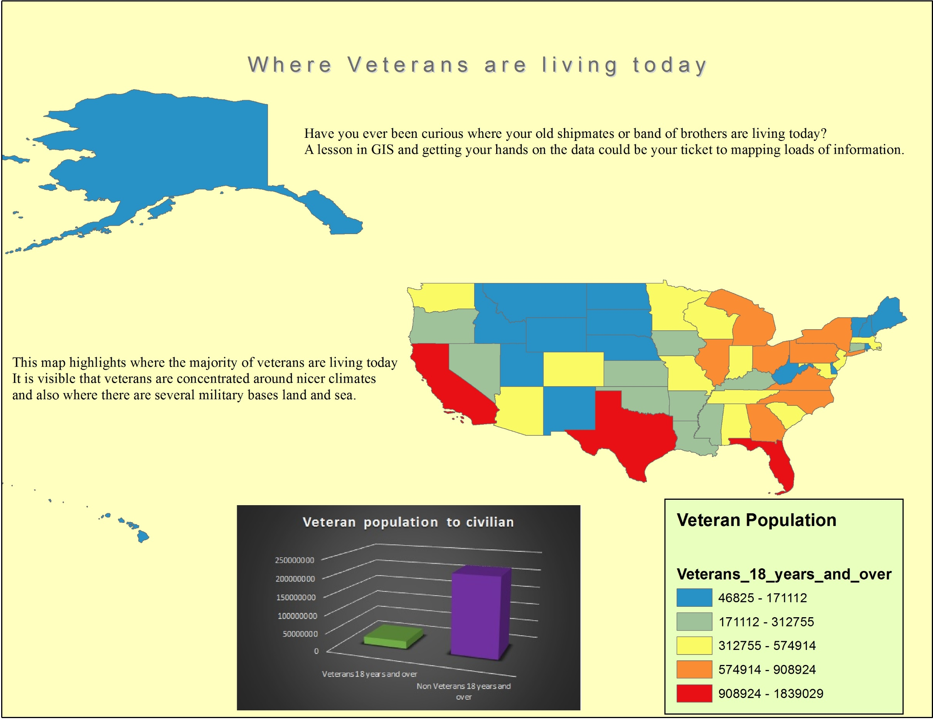
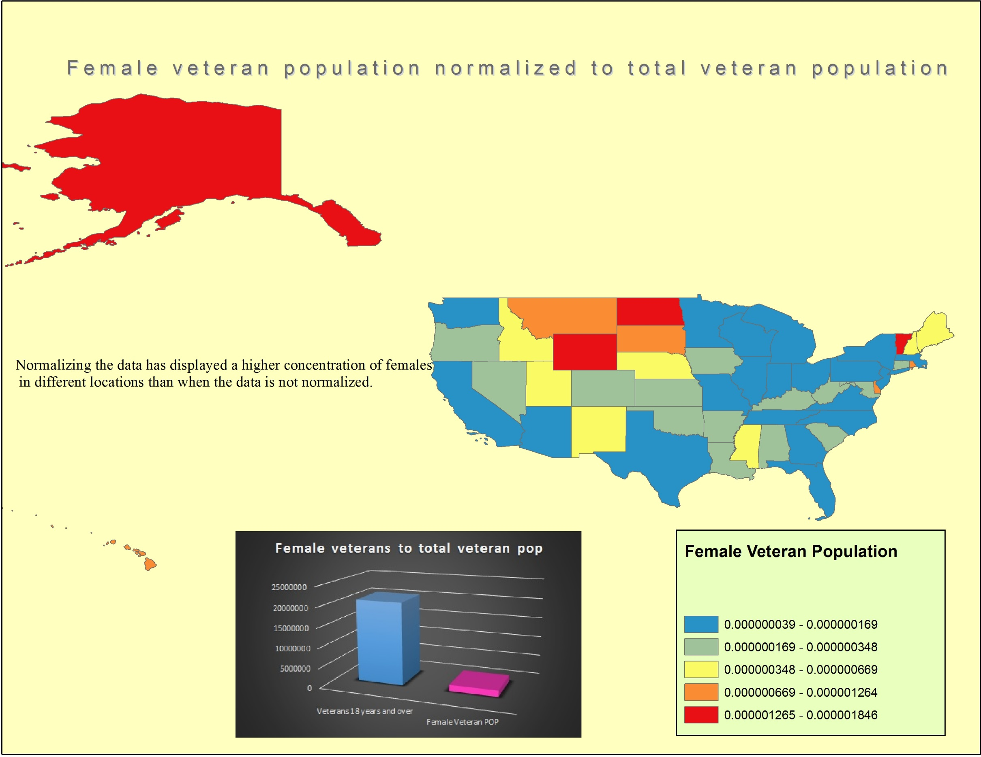
United States Veteran Study of Location And Demographics
The above map shows us where veterans currently reside in the United States. It is apparent that the majority of veterans are living in California, Texas, and Florida. These three states have a high population to begin with but also have a large number of active military installations both land and sea. It’s also a notable fact that climates in these regions stay fairly comfortable and influence larger populations. The graph imbedded with this map shows that the civilian population is extremely dominant over the veteran population, veterans only make up about 10% of the U.S. population.
The above map uses a chropleth design to show the comparison of female veterans to the overall veteran population. As the graph shows the female veteran population is small in comparison to the total veteran population, only about 7.5% of veterans are female. This map shows that there are only four states in the union where there is a large percentage of female veterans.
Kevin Chuba
Geog-1820
04DEC2014
Data Provided by the U.S. Census Bureau 2013

