Slide 1
Final Presentation For Music_1040
By
Kevin Chuba

Slide 2
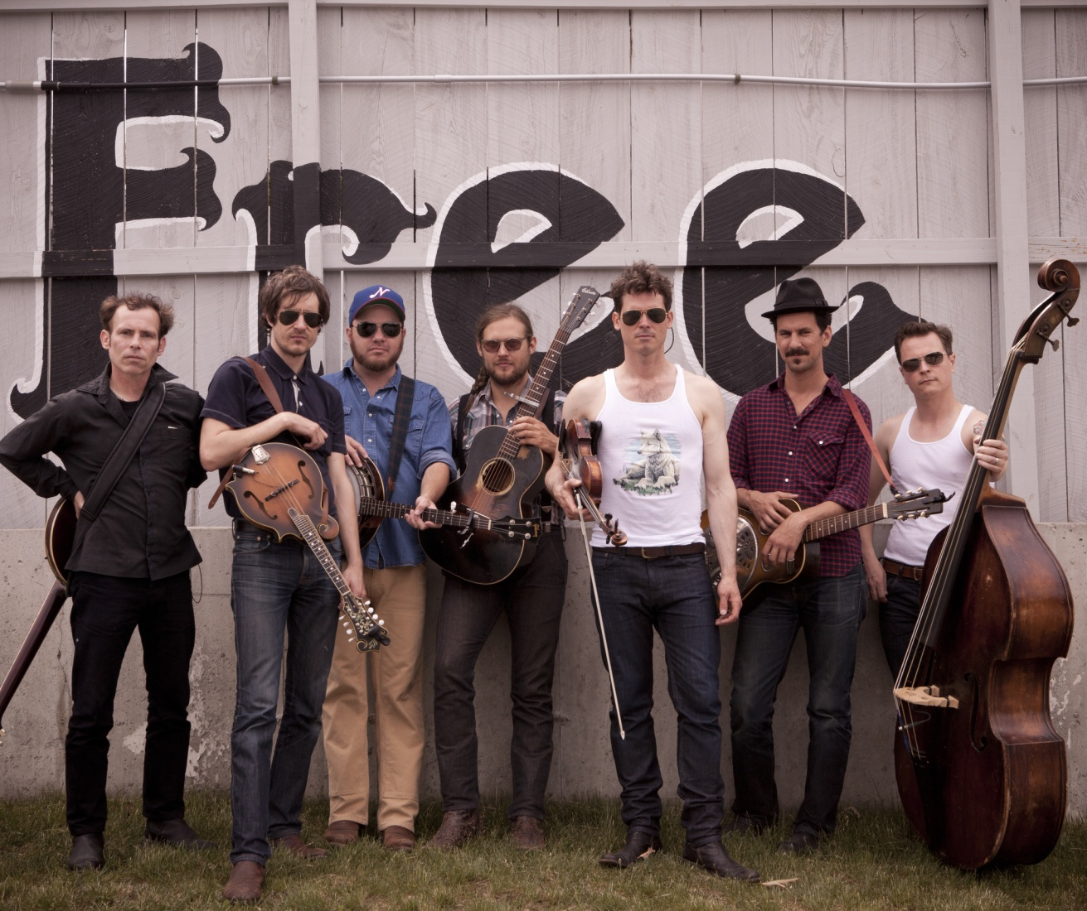
Old Crow Medicine Show
An American string band with old time, folk, and alt-country style

Slide 3
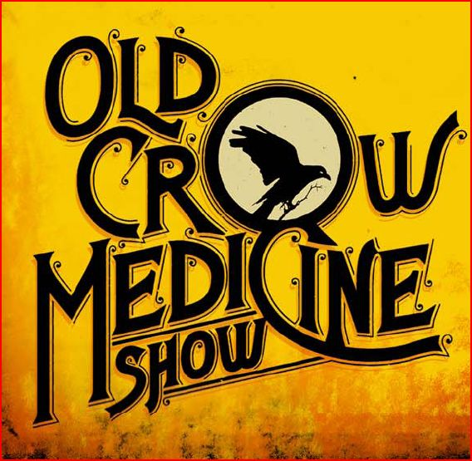
Band Members
Ketch Secor (Fiddle, Harmonica) Critter Fuqua (Guitar, Accordian) Kevin Hayes (Banjo) Morgan Jahnig (Standup Bass) Gill Landry (Resonator Guitar) Chance McCoy (Fiddle, mandolin) Cory Younts (Drums, Keys)
Past Members:
Ben Gould Matt Kinman Willie Watson
Formed in 1998 the band is currently on tour

Slide 4
The Beginning
Ketch And Critter, met when they were in the 7th grade in Harrisburg, VA. and started playing at open mic nights together.
Willie Watson, met Ben Gould during highschool in Watkins Glen, New York. After dropping out of school they formed the band Funniest Game.

Slide 5
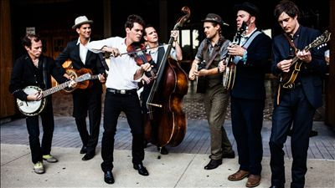
Busking for recognition
While attending Ithaca college Ketch and Critter met Ben and Willie and recorded the album Transmission; that they would later sell while traveling west through Canada.
Busking their way back to the east coast the band was recognized one day on a street corner by country legend Doc Watson. Doc invited them to play at a music festival which kick started Old Crow’s music career.

Slide 6
Influences
Ketch Secor was first influenced by John Hartford in the first grade which made him want to play the banjo.
Critter was influenced by bands like Guns and Roses, Nirvana, AC/DC and a Conjuto band.
Bob Dylan was the most profound influence for Ketch and paved the way for their hit song Wagon Wheel. The song was originally a Dylan song called Rock me mamma but was never finished until Ketch got the copyrights from Dylan and completed his own version. Which has since been covered by other bands.
Song: Wagon Wheel
Album: O.C.M.S.

Slide 7
Awards and honors
Their 2004 album O.C.M.S. was selected by Country Music Television (CMT) as one of the top-10 bluegrass albums of the year.
The band was formally inducted into the Grand Ole Opera.
Their recording of “Wagon Wheel" was certified Platinum and nominated song of the year in 2013

Slide 8
Albums
Old Crow Medicine Show has released six studio albums.
O.C.M.S. (2004)
Big Iron World (2006)
Tennessee Pusher (2008)
Carry Me Back (2012)
Remedy (2014) Grammy award winner in 2015 for best folk albulm
Bushy Mountain Conjugal Trailer (2015) EP
Song: Humdinger
Album: Tennessee Pusher

Slide 9
Conclusion
Old Crow Medicine Show is a fun and down to earth time.
Their music incorporates several stringed instruments that have been played in America for decades.
They have an old time mountain feel to their music, even when surrounded by new world money and technology.
Song: Alabama High Test
Album: Tennessee Pusher

Slide 10
References
http://en.wikipedia.org/wiki/Old_Crow_Medicine_Show
Google Images
http://www.gactv.com/gac/ar_artists_a-z/article/0,3028,GAC_26071_5938577_,00.html

