Slide 1
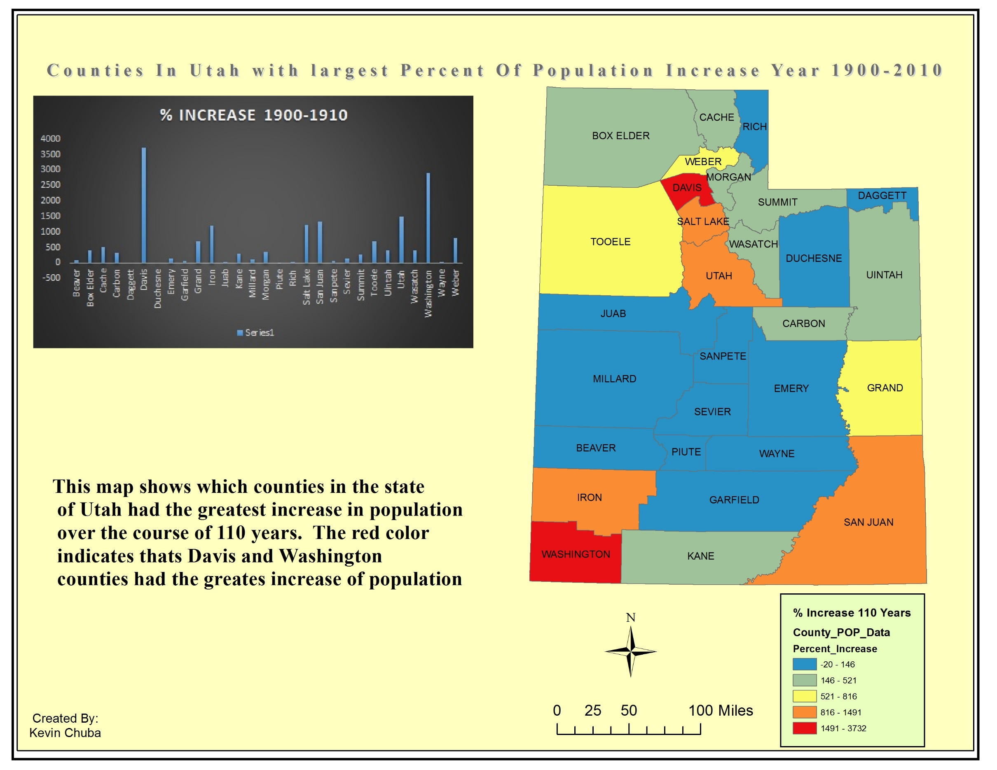
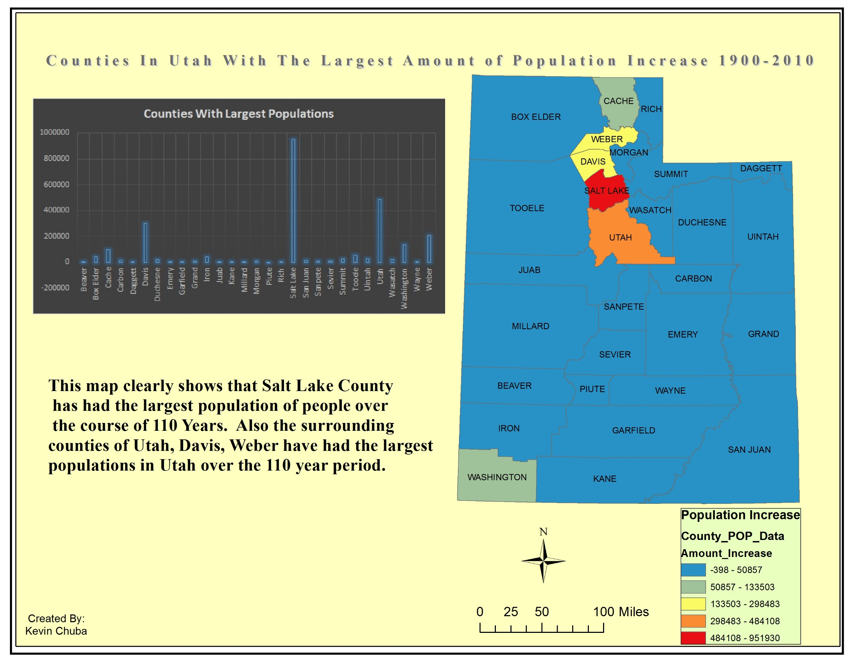
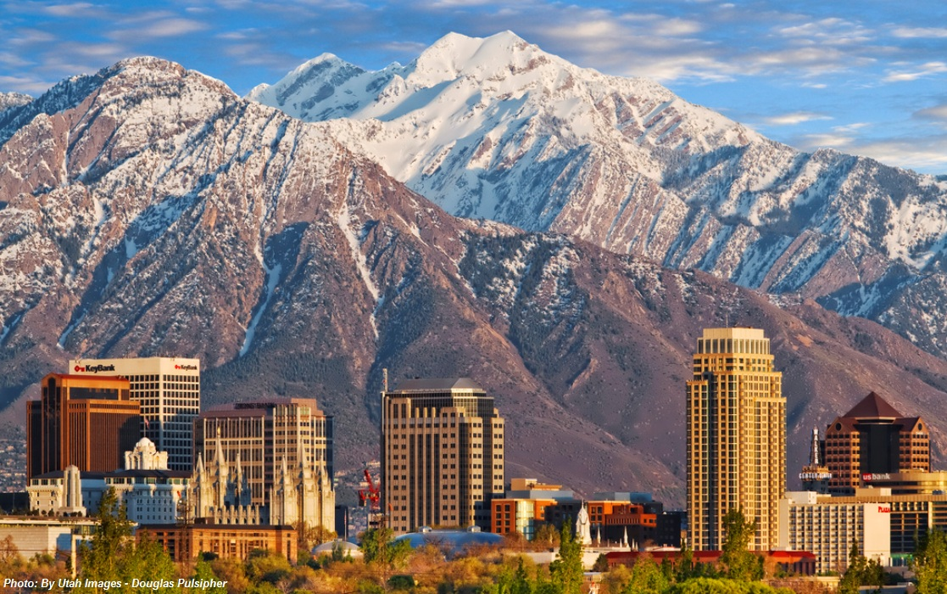
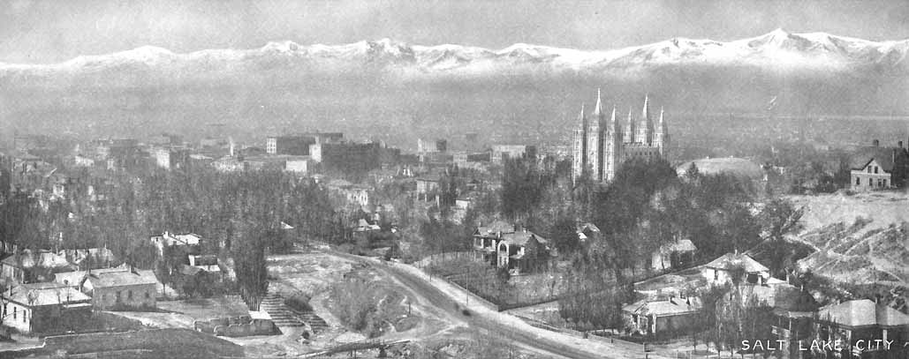
110 YEARS OF POPULATION CHANGE IN UTAH
Data Provided by U.S. Census Bureau
Data Provided By U.S. Census Bureau
Over the course of one hundred and ten years, Utah has changed significantly both the landscape and the people who occupy it’s counties. This map enables us to see which counties have increased the fastest and which counties have had the greatest increase in population. As you can see Washington and Davis counties had the greatest percent of increased population and Salt Lake county remained the largest population of people.

